Slide 1
Webscraping in FinEco Research: Risks and Opportunities
Cynthia A. Huang
Econometrics & Business Statistics, Monash University

Slide 2
Introduction

Slide 3
About Me
👩‍🎓 PhD Candidate in Monash EBS, affiliated with
NUMBATS (EBS), SoDa Labs (ECON), EmVis (Faculty of IT)
Monash Data Futures Institute
Researching principles and methods for "alternative" data
conceptual and practical data provenance tools for harmonised multi-source datasets
adapting web-scraped retail product & price data for public health research
Statistical properties of alternative data, grammar of graphics
Open and reproducible research tools, research software design
Quarto, git, replication packages
NUMBATS Hacky hour, community building

Slide 4
Objectives
🤔 Research opportunities & risks
Big data, novel data, alternative data
Operational vs. scientific risk
Web technologies and web-scraping methods
Ethical & legal risk
❌ How to code a web-scraper
❌ How to code big-data analysis
✅ Project level considerations
✅ Resourcing web-scraping projects (skill sets, RA hires etc.)

Slide 5
Web scraping—verb.
Cambridge dictionary:
the activity of taking information from a website or computer screen and putting it into an ordered document on a computer
WWW
HTML
JSON
Retrieve
Parse
IMAGES
...

Slide 6
Web scraping—verb.
Cambridge dictionary:
the activity of taking information from a website or computer screen and putting it into an ordered document on a computer
WWW
HTML
JSON
Retrieve
Parse
IMAGES
...
CSV
XLSX
...

Slide 7
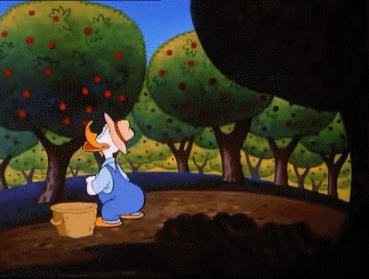
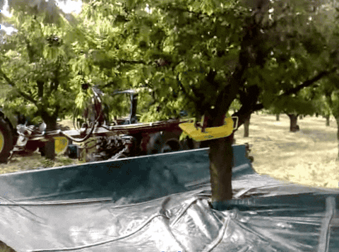
Web scraped data—noun.
Cambridge dictionary:
the activity of taking information from a website or computer screen and putting it into an ordered document on a computer
Notes:
Anything can be webs-scraped data?
But downloading a dataset from a website doesn’t quite fit in our common understanding of web-scraped data…
A different collection method leads to different qualities of the data

Slide 8
Common properties of web scraped data
Some degree of messiness
Collection, preparation
Analysis, statistical properties
Non-trivial parsing from raw web extraction to analysis-ready data
Murky data dimensions/quality
How many records?
How many observational units?
Complete/missing observations?
Notes:
Anything can be web-scraped data?
But downloading a dataset from a website doesn’t quite fit in our common understanding of web-scraped data…
- Web data (delivered on a platter)
Different collection method leads to different qualities of the data
”messiness”: practical & conceptual
Parsing
Data quality/description

Slide 9
Research Opportunities & Risks

Slide 10
Big, novel, alternative (data) opportunities
The internet is a rapidly expanding universe of (collectable*) data
Multiple modalities: text, images, video…
Multi-source harmonization: shopping aggregators, knowledge graphs
Novel signal sources: social media sentiment, digitial economy indicators
Lower* cost than traditionally available data collection methods
Digital vs. Analogue access and delivery
Automated data extraction vs. Manual data entry
Volume, Velocity, Variety… Veracity?
Noise vs. signal for data mining, prediction, casual inference
Collecting data from a Complex System vs. Library
Notes:
Incentives & dynamics of the internet as an information generating and storing system vs. libraries

Slide 11
Research Risk: Traditional Data
Operational Risk
Scientific Risk
Availability and Access
Cost
Legal and ethical
Suitable analysis methods
Signal-to-noise ratio (in context)
Data quality

Slide 12
Research Risk: Web Scraped Data
Operational Risk
Scientific Risk
Cost = Time
Availability and access
Sampling bias
Unstable web interfaces
Legal and ethical
Usage terms
Data quality
Completeness
Accuracy
Signal-to-noise ratio
Big Data Paradox (Bradley et al., 2021)
Suitable analysis methods
Data Collection Scope
Conceptual Scope
Notes:
Question to the audience – who can guess why the facebook estimate was so wrong?

Slide 13
Web Scraped Data Risk
Resource Sink
Resource Sink
Maintenance Trap
Operational
Example dataset description:
Daily stock prices
Conceptually and operationally open-ended
Unclear dataset dimensions
Which firms?
What time period?
Conceptual
Scope
Sampling Bias
Research Quality Dataset
Scope

Slide 14
Web Scraped Data Risk
Maintenance Trap
Resource Sink
Maintenance Trap
Operational
Example dataset description:
Daily prices for alcoholic beverages sold online by retailers with physical stores in Australia
Conceptually limited, but operationally open-ended
implies ongoing collection:
Repair “broken” scrapers
Upgrade storage & compute
(Cavallo & Rigobon, 2016)
Conceptual
Scope
Sampling Bias
Research Quality Dataset
Scope

Slide 15
Web Scraped Data Risk
Sampling bias
Resource Sink
Maintenance Trap
Operational
Example dataset description:
Daily prices for alcoholic beverages available online between Jan-Dec 2023
Operationally limited, but conceptually open-ended
What population is being sampled from?
Index coverage (Foerderer, 2023)
Conceptual
Scope
Sampling Bias
Research Quality Dataset
Scope

Slide 16
Web Scraped Data Risk
Research Quality Dataset(s)
Resource Sink
Maintenance Trap
Operational
Conceptually and operationally limited
Quality is context dependent!
Requires deliberate design decisions
Filtering criteria (e.g. top products, largest retailers)
Conversion between observation and analysis resolution (e.g. from retailer to brand)
Conceptual
Scope
Sampling Bias
Research Quality Dataset
Scope

Slide 17
Business vs. Research Needs
Data Harvesting
Business Monitoring
Snapshot
Market Research
Resource Sink
Maintenance Trap
Operational
Conceptual
Scope
Sampling Bias
Research Quality Dataset
Scope

Slide 18
Case Study
Adapting web scraped retail price data for public health research

Slide 19
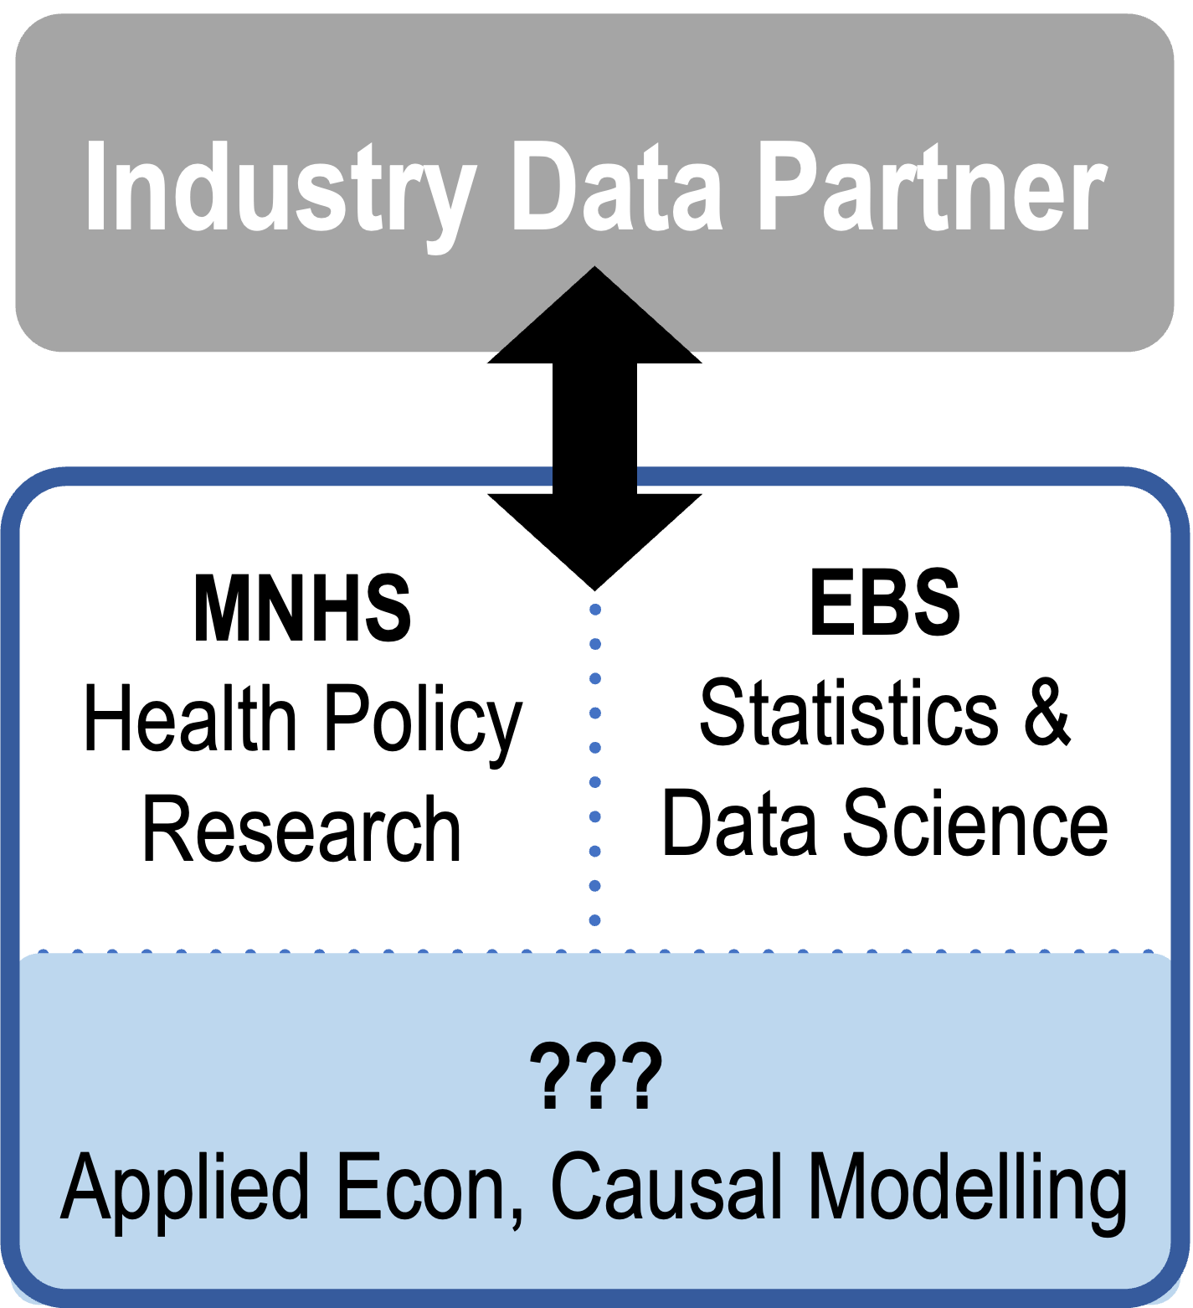
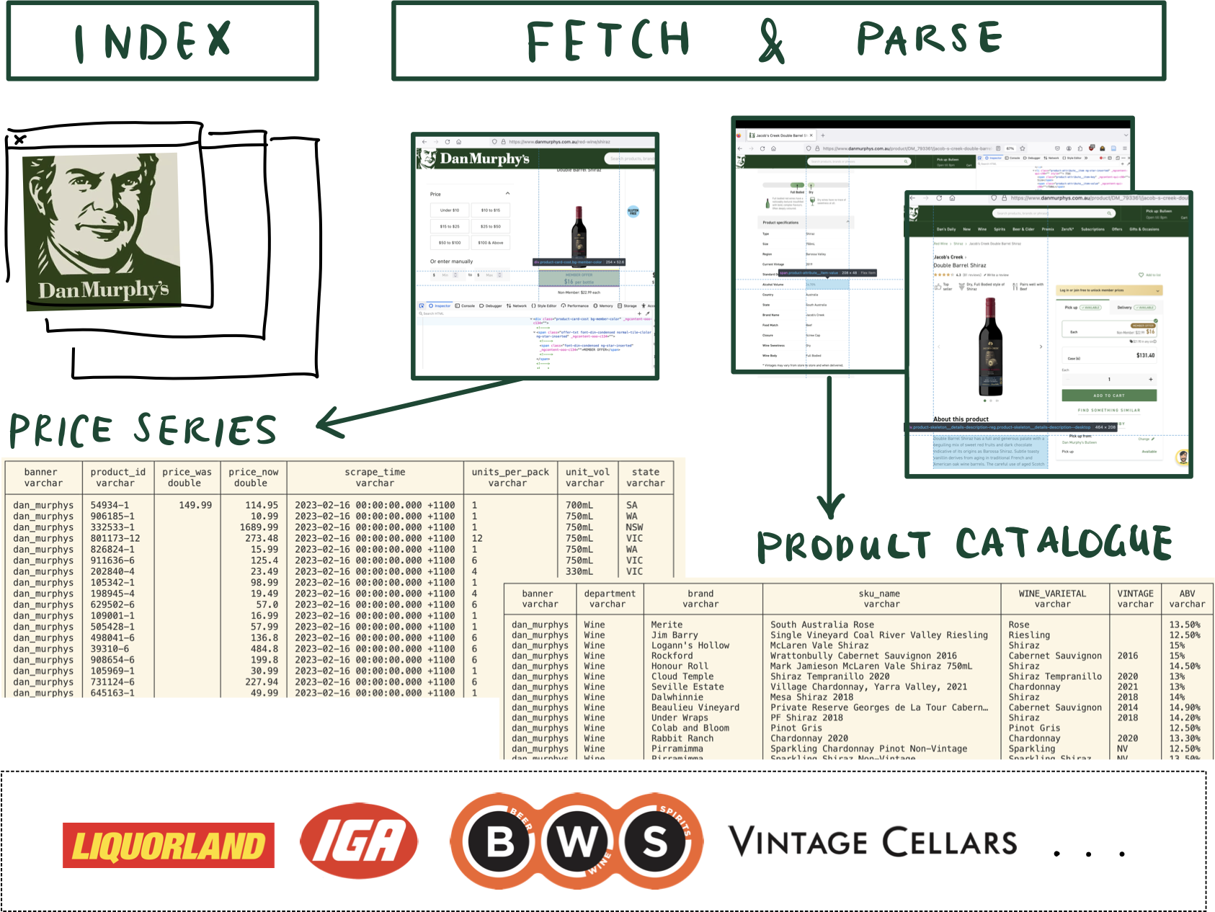
Outsourcing web scraping

Slide 20
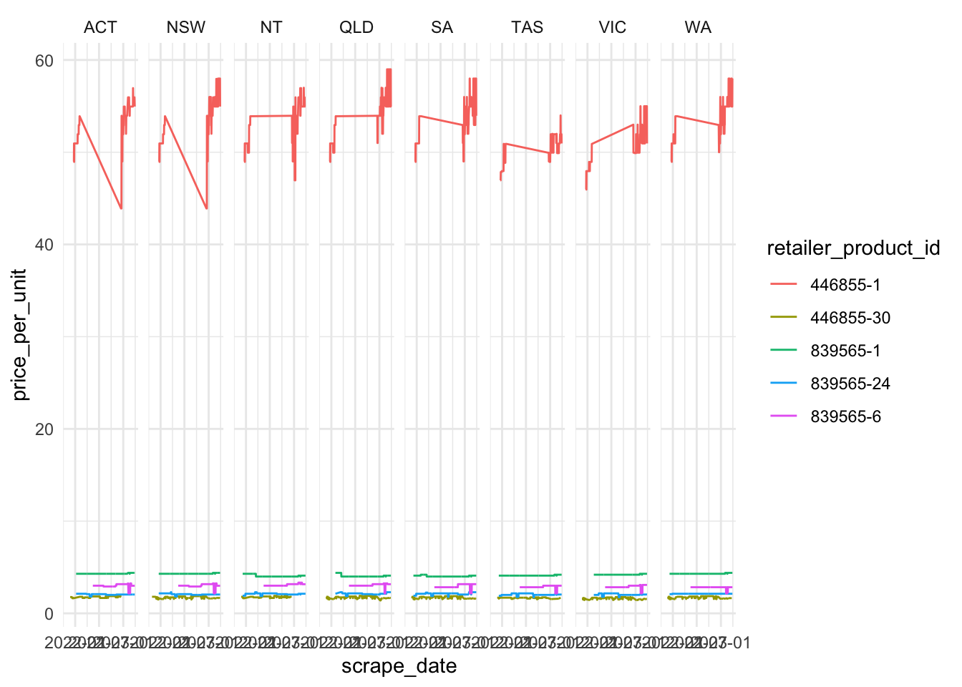
Data refinements & augmentation
Anomalies in cross-retailer harmonisation
Augmenting product attributes
Product name
Brand name
Manufacturer
Product category
Volume per unit
Alcohol by Volume
Standard drinks per unit

Slide 21
Web technologies, access interfaces, and collection methods

Slide 22
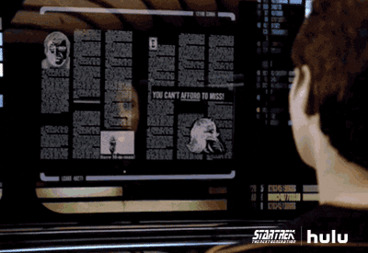
Web scraping: Expectations vs. Reality
Notes:
Operational risk

Slide 23

Web scraping: Expectations vs. Reality
Notes:
This is where operational/collection risk comes from!

Slide 24
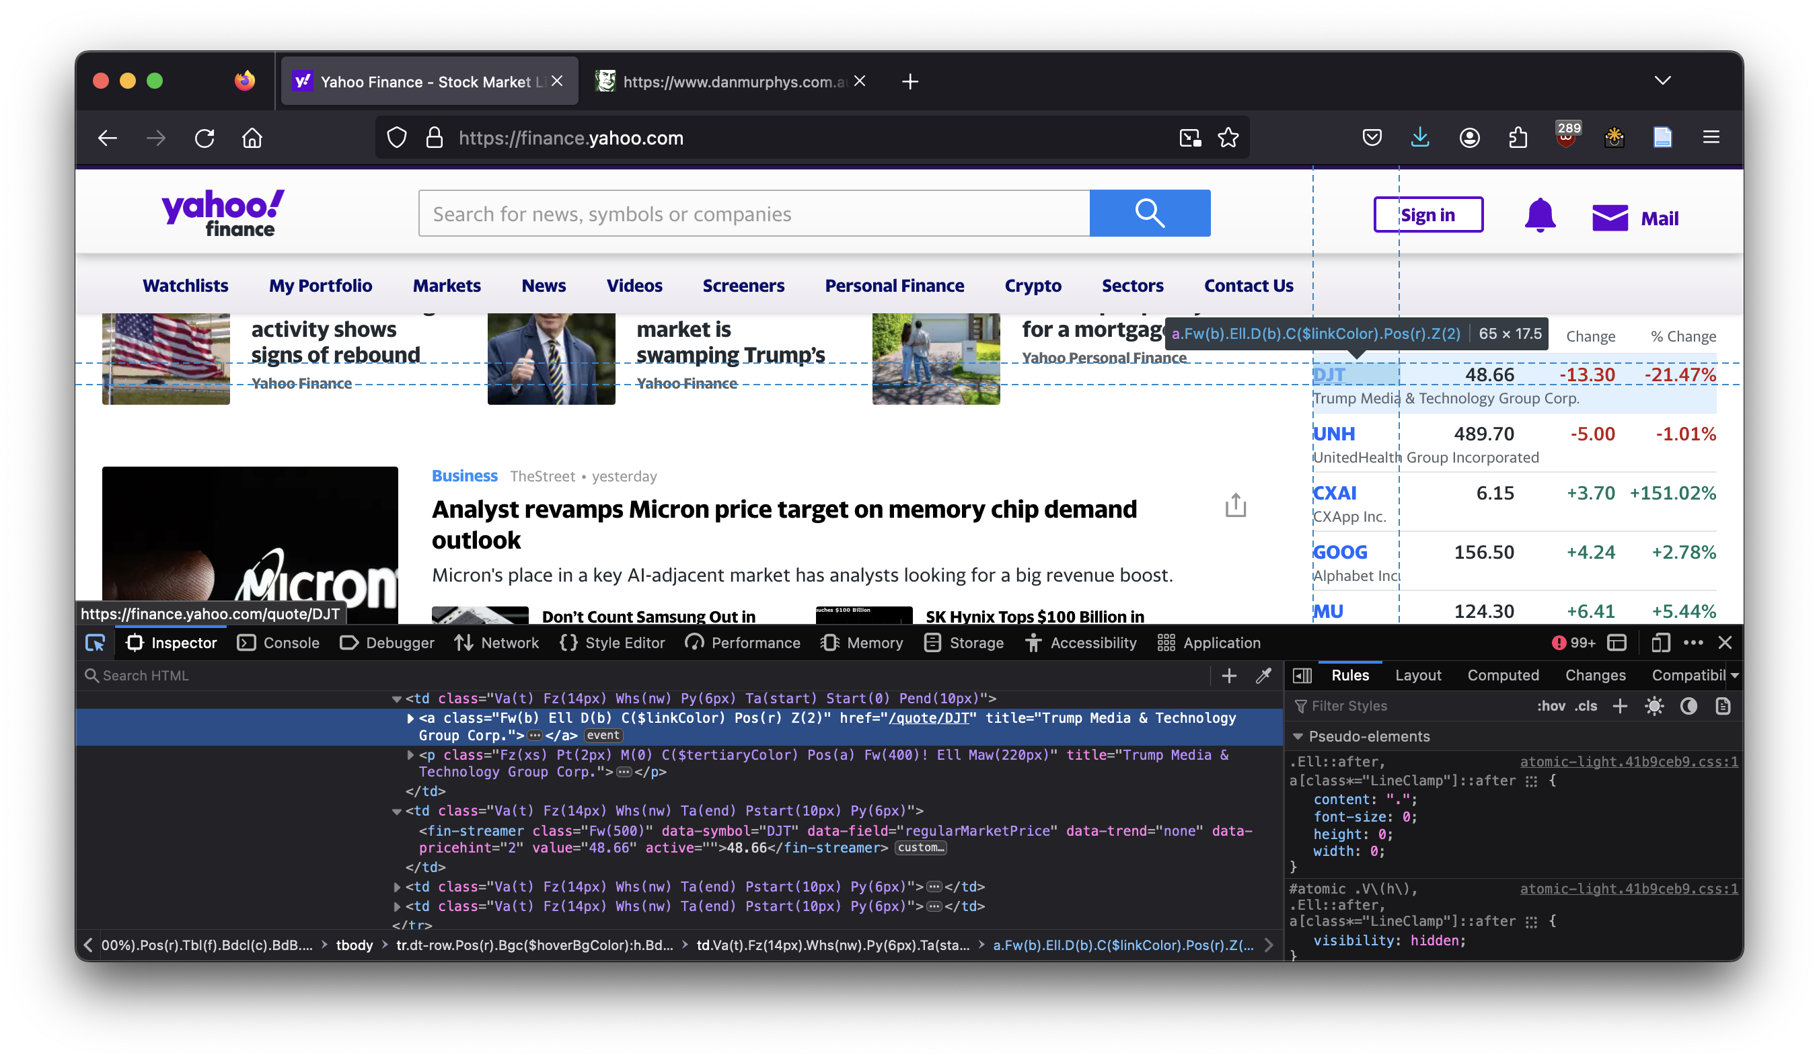
Live Demo
HTML elements
API responses

Slide 25
Web technologies
Webpages and websites
Styling: CSS
Static content: HTML/XML
Dynamic content: Javascript, API queries
Web Protocols (HTTP/HTTPS)
Application Programming Interface (APIs)
Query parameters
Response formats: JSON, CSV…
Notes:
Words to google, learn by osmosis in demo

Slide 26
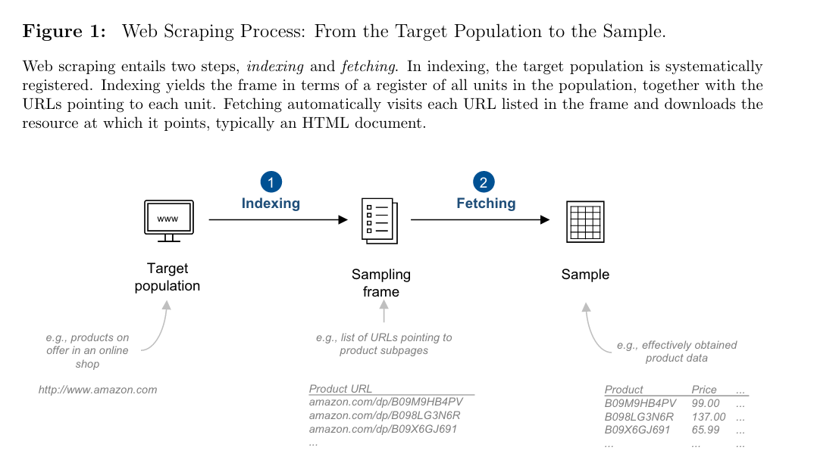
Web scraping methods: Indexing & Crawling
Source: Foerderer, 2023

Slide 27
Web scraping methods: Retrieval
Manual Copy-Paste
Concurrent* collection & parsing
Human errors and judgement
Interactive collection
Automating mouse/keyboard inputs
Via headless browsers
Selenium, chromium etc.
Request-based extraction
Request resources using machine readable methods
HTTP CONNECT/GET
API Queries
Notes:
Which method you use depends on the website architecture
concurrent* collection & parsing
human errors

Slide 28
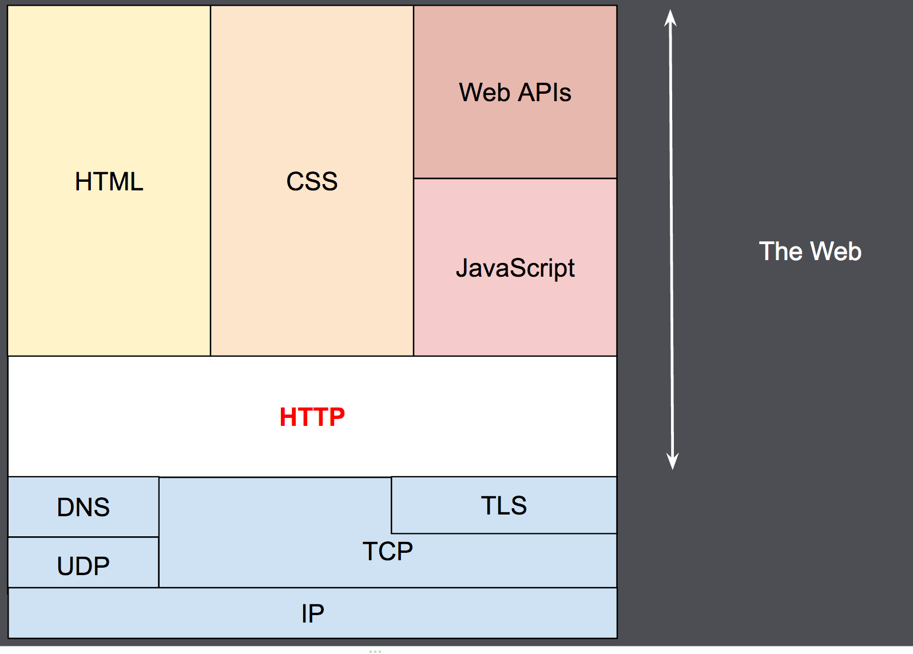
Web scraping methods: Parsing
HTML element extraction:
Tables, if you’re lucky
Often requires detangling style information from metadata and data
API response parsing:
A way for computers to talk to computers without human readability/presentation layer
Deciphering JSON keys can be tricky without access to dictionary
An overview of HTTP - HTTP | MDN. (2023, December 16). https://developer.mozilla.org/en-US/docs/Web/HTTP/Overview
Notes:
What parsing is depends on what formats are available & what you are looking to collect
- PDFs, getting data out

Slide 29
Collection Risk by Method / Format
Method | Access Stability | Access Difficulty | Parsing Complexity | Common raw formats
Manual | M | L | L-H??? | …
Interactive sessions | L | H | M-H | HTML elements
HTTP page requests | M | L | M-H | HTML elements
API queries | H | L-M | L | JSON, CSV…

Slide 30
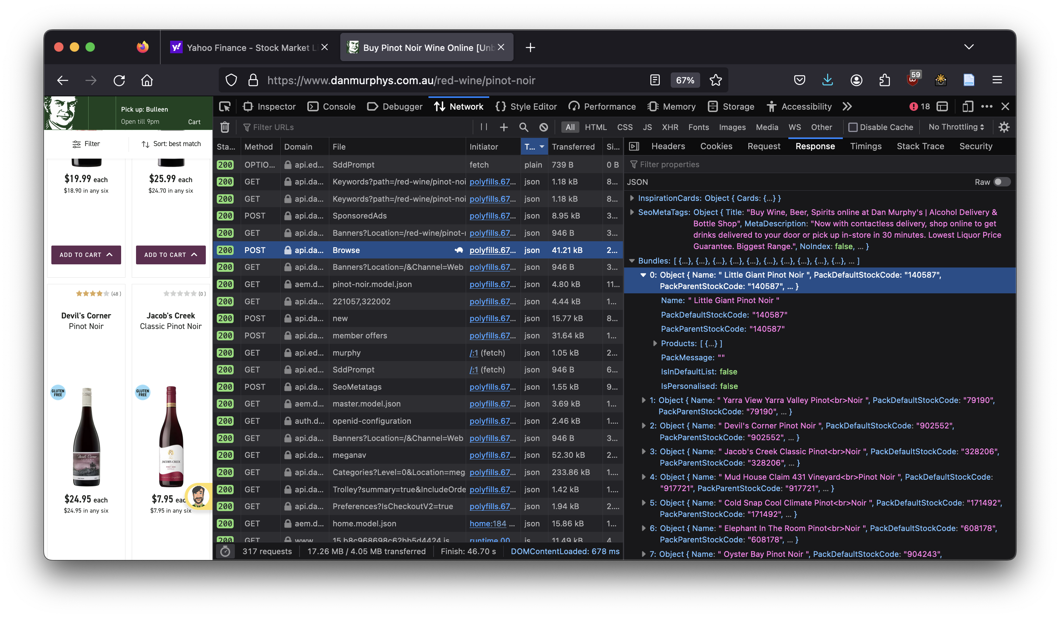
Live Demo
HTML elements
API responses

Slide 31
Final considerations

Slide 32
Ethical & Legal Risk: Retrieval
API (authorized)
Manual entry
Interactive sessions
Automated extraction
API (…unauthorized)
Notes:
Polite: query & response// traffic & server load --- DON’T CRASH THE WEBSITE
- API (authorized)
- Manual entry
- Interactive sessions – robots.txt
- Automated extraction – robots.txt, {polite}
- API (…unauthorized) – OPTUS leak “hack”

Slide 33
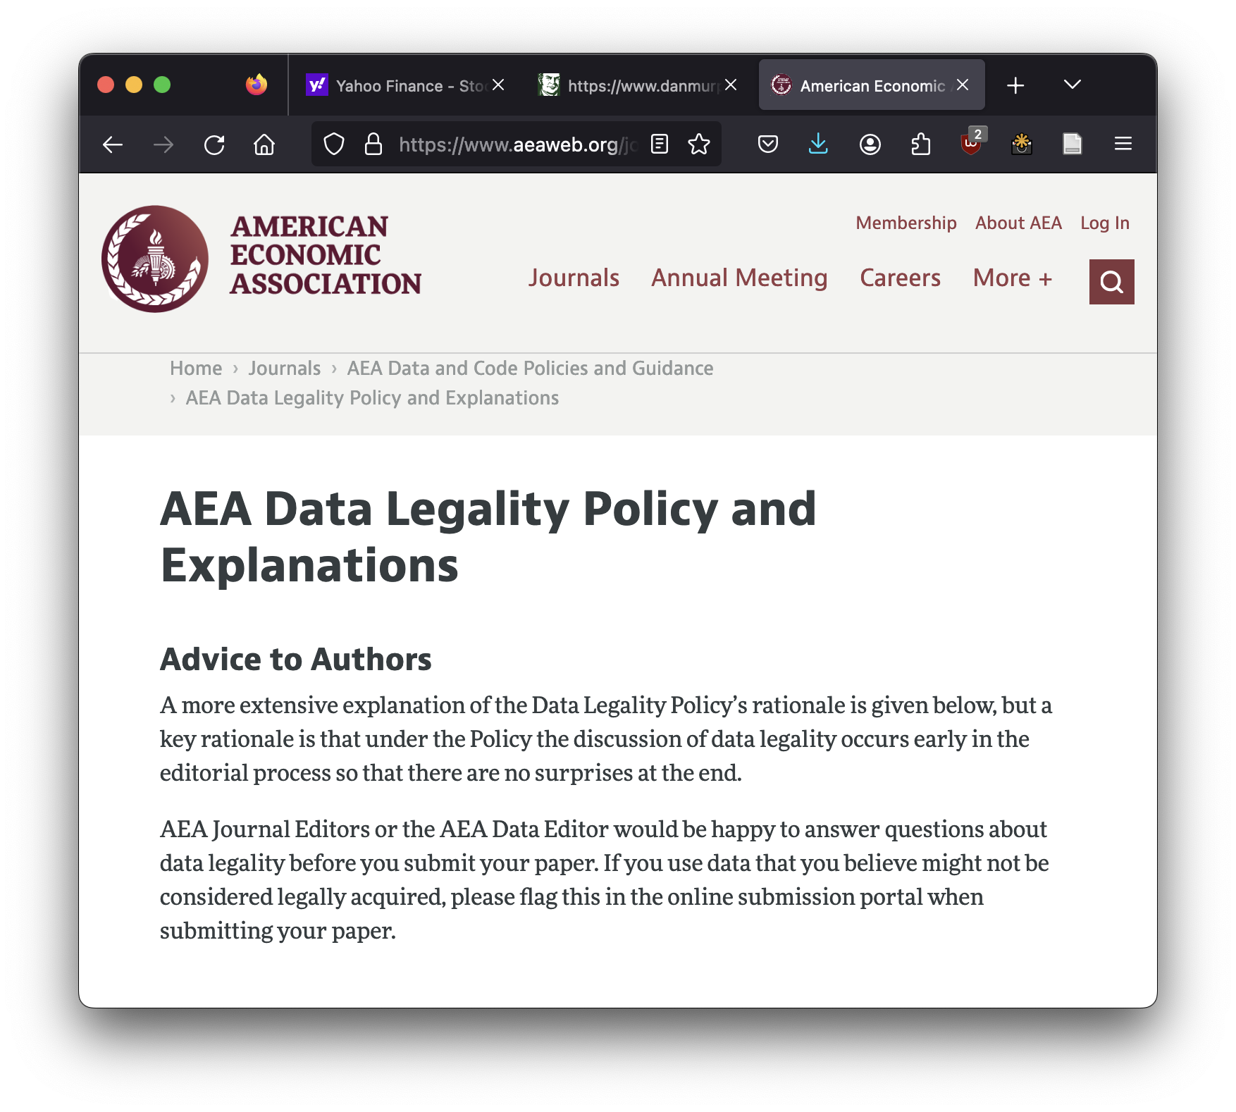
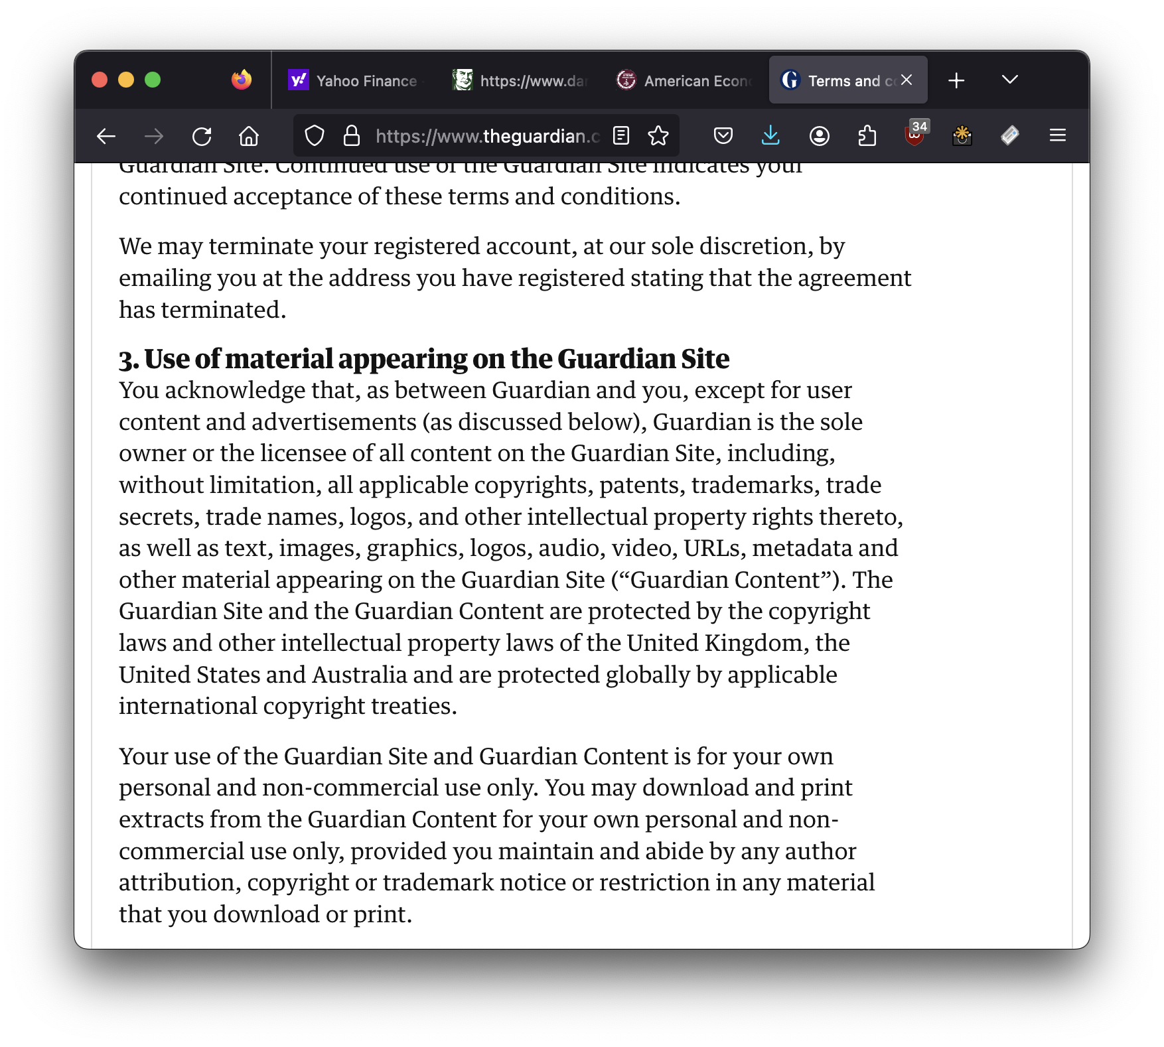
Ethical & Legal Risk: Data Usage
It depends, check…
Website T&Cs
Journal policies
robots.txt
…

Slide 34
Starting a Web Scraped Data Project?
Assess Feasibility & Quality:
Inspect webpages
Assess consistency
How many different webpage architectures?
Consider data collection vs. analysis unit/resolution
Define ”research quality” in your context
Consider website and data owner motives
Are there any incentives to obfuscate data?
Resource appropriately:
For in-house hires, consider experience & knowledge of:
Retrieval methods,
Scraping etiquette,
Parsing methods,
Data wrangling
Consider industry partners if available
Paid services can be suitable for limited data collection
Notes:
Before you hire an RA
Inspect webpage
pinpoint data interfaces
Assess website consistency
Webpage differences (different companies)
Consider business incentives (website owner motives)
(i.e. more proprietary value = more barriers/obfuscation)
Temporary passwords/cookies → dynamic content
More complexity = more likely RA skills could limit project success
Hire for etiquette, likely methods, not just “web-scraping”
Consider industry data partner

Slide 35
Appendix

Slide 36
Resources
Web-scraping in R
Extended tutorial by Hadley Wickham:
https://github.com/hadley/web-scraping
Scraping tools:
https://rvest.tidyverse.org
Polite sessions:
https://github.com/dmi3kno/polite

Slide 37
Case Study: Resource Sink
“Although gathering this massive amount of prices was cheaper online than with traditional methods, it required funding that could not be sustained through grants. Thus, in 2011 we started a company called PriceStats that now collects the data and produces high-frequency indexes for central banks and financial-sector customers.” (Cavallo and Rigobon, 2016, p. 153)

Slide 38
AEA Data Legality Policy
“A particular concern expressed by many researchers is the treatment of computer-assisted acquisition of data (“scraped data”) when such acquisition contravenes terms of use of the data owner. While scraping may contravene terms of use, it may not be illegal. Its legality is not settled under current US law (as of January 2023). Editors will treat papers with scraped data as legally acquired as long as this issue is unsettled when the paper was submitted. Should it in the future become settled law that scraped data is illegal, the AEA will communicate how scraped data will be treated under the Policy."
https://www.aeaweb.org/journals/data/data-legality-policy

Slide 39
References
Slide 10: Sagiroglu, S., & Sinanc, D. (2013). Big data: A review. 2013 International Conference on Collaboration Technologies and Systems (CTS), 42–47. https://doi.org/10.1109/CTS.2013.6567202
Slide 12: Bradley, V. C., Kuriwaki, S., Isakov, M., Sejdinovic, D., Meng, X.-L., & Flaxman, S. (2021). Unrepresentative big surveys significantly overestimated US vaccine uptake. Nature, 600(7890), 695–700. https://doi.org/10.1038/s41586-021-04198-4
Slide 14: Cavallo, A., & Rigobon, R. (2016). The Billion Prices Project: Using Online Prices for Measurement and Research. Journal of Economic Perspectives, 30(2), 151–178. https://doi.org/10.1257/jep.30.2.151
Slide 15,26: Foerderer, J. (2023). Should we trust web-scraped data? (arXiv:2308.02231). arXiv. http://arxiv.org/abs/2308.02231
Slide 24: Nigam, H., & Biswas, P. (2021). Web Scraping: From Tools to Related Legislation and Implementation Using Python. In J. S. Raj, A. M. Iliyasu, R. Bestak, & Z. A. Baig (Eds.), Innovative Data Communication Technologies and Application (Vol. 59, pp. 149–164). Springer Singapore. https://doi.org/10.1007/978-981-15-9651-3_13

Slide 40
Business vs. Research needs
Resource Sink
Maintenance Trap
Sampling Bias
Research Quality Dataset
Maintenance Trap -> Real time business monitoring/intelligence
Resource Sink -> Data Mining
Notes:
Segue to my work between maintenance trap & research quality

Slide 41
Collection vs Conceptual Risk
Resource Sink
Maintenance Trap
Sampling Bias
Research Quality Dataset
Resource Sink
Example dataset description:
Daily prices for alcoholic beverages
Conceptually and operationally open-ended
Unclear dataset dimensions
Which products? websites? stores?
What time period?

